Slide 1
INTRODUCTION TO DEEP LEARNING
Module 2

Slide 2
INTRODUCTION TO DEEP LEARNING
Gradient Descent, Back Propagation Algorithm: – Mitigation – RelU Heuristics for Avoiding Bad Local Minima – Heuristics for Faster Training – Nestor’s Accelerated Gradient Descent –Regularization – Dropout.

Slide 3
Gradient Descent
Gradient descent is an optimization algorithm used in machine learning and neural networks to minimize the cost or loss function.
In neural networks, the cost or loss function measures the difference between the predicted output of the network and the actual output.
The basic idea of gradient descent is to iteratively adjust the parameters of the neural network in the direction of the negative gradient of the cost function with respect to those parameters. This process continues until the cost function reaches a minimum or converges to a small value.
The negative of the gradient (−∇J(θ)) points in the direction of the steepest decrease, which is the direction we want to move to minimize the cost function.

Slide 4
Cost Function quantifies the error between predicted values and expected values and presents it in the form of a single real number.
And with a goal to reduce the cost function, we modify the parameters by using the Gradient descent algorithm over the given data.
Gradient descent is an iterative algorithm, that starts from a random point on a function and travels down its slope in steps until it reaches the lowest point of that function

Slide 5
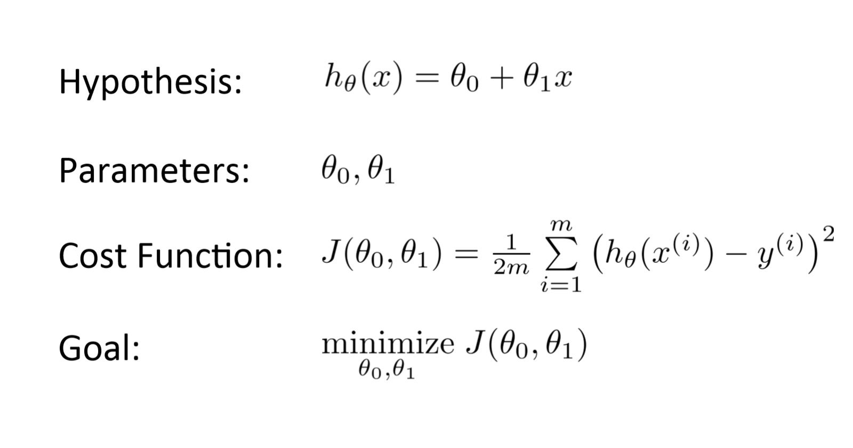
mathematical representation

Slide 6
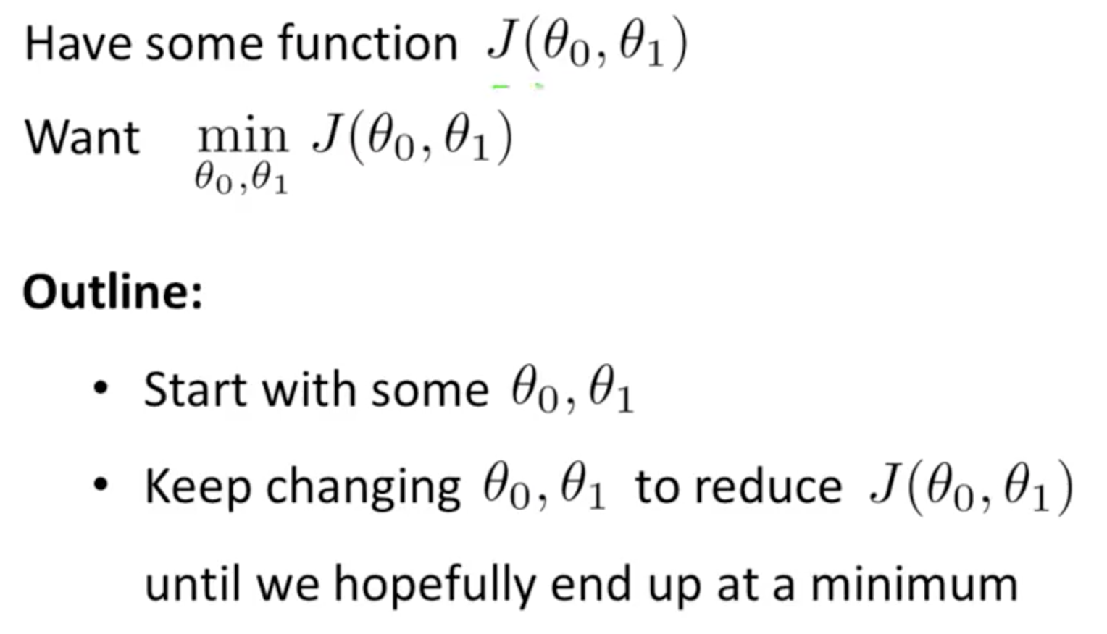

Slide 7
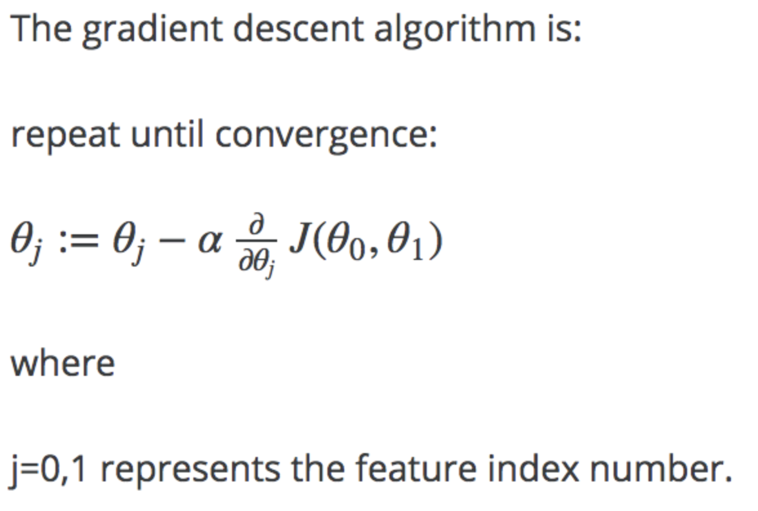

Slide 8
Gradient descent is an iterative optimization algorithm for finding the local minimum of a function.
To find the local minimum of a function using gradient descent, we must take steps proportional to the negative of the gradient (move away from the gradient) of the function at the current point.
If we take steps proportional to the positive of the gradient (moving towards the gradient), we will approach a local maximum of the function, and the procedure is called Gradient Ascent.

Slide 9
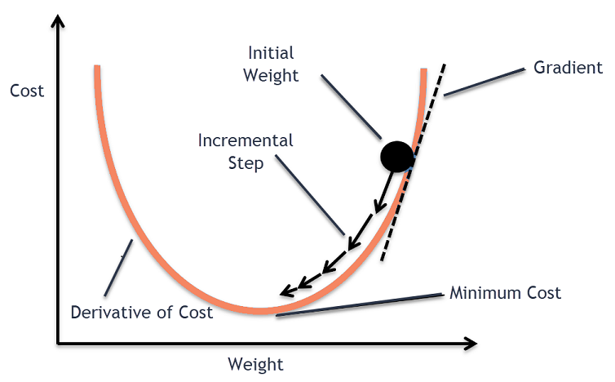

Slide 10
The goal of the gradient descent algorithm is to minimize the given function (say cost function). To achieve this goal, it performs two steps iteratively:
Compute the gradient (slope), the first order derivative of the function at that point
Make a step (move) in the direction opposite to the gradient, opposite direction of slope increase from the current point by alpha times the gradient at that point.

Slide 11
Gradient Descent Algorithm
The steps of the algorithm are
Find the slope of the objective function with respect to each parameter/feature. In other words, compute the gradient of the function.
Pick a random initial value for the parameters (differentiate “Cost function” with respect to “Weight” as well as “bias”). Update the gradient function by plugging in the parameter values.
Calculate the step sizes for each feature as : step size = gradient * learning rate.
Calculate the new parameters as : new params = old params -step size
Repeat steps 3 to 5 until gradient is almost 0.

Slide 12
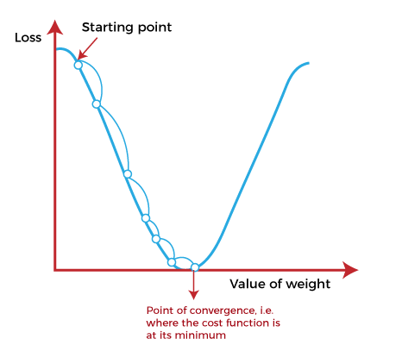
The starting point(shown in fig) is used to evaluate the performance as it is considered just as an arbitrary point
At this starting point, we will derive the first derivative or slope. Further, this slope will inform the updates to the parameters (weights and bias).
The slope becomes steeper at the starting point or arbitrary point, but whenever new parameters are generated, then steepness gradually reduces, and at the lowest point, it approaches the lowest point, which is called a point of convergence.
The main objective of gradient descent is to minimize the cost function or the error between expected and actual. To minimize the cost function, two data points are required:

Slide 13
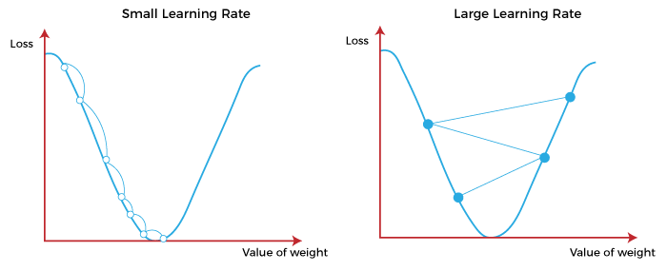
Learning Rate
Alpha – The Learning Rate
It must be chosen carefully to end up with local minima.
If the learning rate is too high, we might OVERSHOOT the minima and keep bouncing, without reaching the minima
If the learning rate is too small, the training might turn out to be too long

Slide 14
Learning Rate
a) Learning rate is optimal, model converges to the minimum
b) Learning rate is too small, it takes more time but converges to the minimum
c) Learning rate is higher than the optimal value, it overshoots but converges
d) Learning rate is very large, it overshoots and diverges, moves away from the minima, performance decreases on learning

Slide 15
Types of Gradient Descent
The choice of gradient descent algorithm depends on the problem at hand and the size of the dataset.
Batch gradient descent is suitable for small datasets, while stochastic gradient descent algorithm is more suitable for large datasets.
Mini-batch is a good compromise between the two and is often used in practice.
Batch Gradient Descent
Batch gradient descent updates the model’s parameters using the gradient of the entire training set.
It calculates the average gradient of the cost function for all the training examples and updates the parameters in the opposite direction.
Batch gradient descent guarantees convergence to the global minimum, but can be computationally expensive and slow for large datasets.

Slide 16
Types of Gradient Descent
Stochastic Gradient Descent
Stochastic gradient descent updates the model’s parameters using the gradient of one training example at a time.
It randomly selects a training example, computes the gradient of the cost function for that example, and updates the parameters in the opposite direction.
Stochastic gradient descent is computationally efficient and can converge faster than batch gradient descent. However, it can be noisy and may not converge to the global minimum.

Slide 17
Types of Gradient Descent
Mini-Batch Gradient Descent
Mini-batch gradient descent updates the model’s parameters using the gradient of a small subset of the training set, known as a mini-batch.
It calculates the average gradient of the cost function for the mini-batch and updates the parameters in the opposite direction.
Mini-batch gradient descent algorithm combines the advantages of both batch and stochastic gradient descent, and is the most commonly used method in practice.
It is computationally efficient and less noisy than stochastic gradient descent, while still being able to converge to a good solution.

Slide 18
Vanishing Gradient Problem
As the backpropagation algorithm advances backward from the output layer towards the input layer, the gradients often get smaller and smaller and approach zero which eventually leaves the weights of the initial or lower layers nearly unchanged. As a result, the gradient descent never converges to the optimum. This is known as the vanishing gradients problem.
The sigmoid function is one of the most popular activations functions used for developing deep neural networks.
The use of sigmoid function restricted the training of deep neural networks because it caused the vanishing gradient problem.
This caused the neural network to learn at a slower pace or in some cases no learning at all.

Slide 19
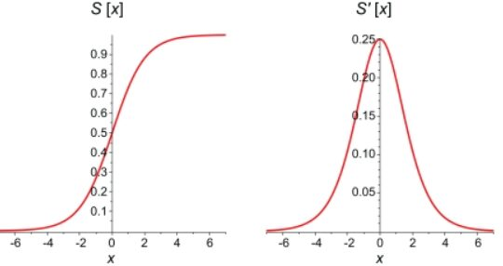
On the graph below you can see a comparison between the sigmoid function itself and its derivative.
First derivatives of sigmoid functions are bell curves with values ranging from 0 to 0.25.

Slide 20
Vanishing Gradient Problem
For the nodes with sigmoid activation functions, we know that the partial derivative of the sigmoid function reaches a maximum value of 0.25.
When there are more layers in the network, the value of the product of derivative decreases until at some point the partial derivative of the loss function approaches a value close to zero, and the partial derivative vanishes.
We call this the vanishing gradient problem.

Slide 21
Vanishing Gradient Problem
With shallow networks, sigmoid function can be used as the small value of gradient does not become an issue.
When it comes to deep networks, the vanishing gradient could have a significant impact on performance.
The weights of the network remain unchanged as the derivative vanishes.
During back propagation, a neural network learns by updating its weights and biases to reduce the loss function. In a network with vanishing gradient, the weights cannot be updated, so the network cannot learn.
The performance of the network will decrease as a result.

Slide 22
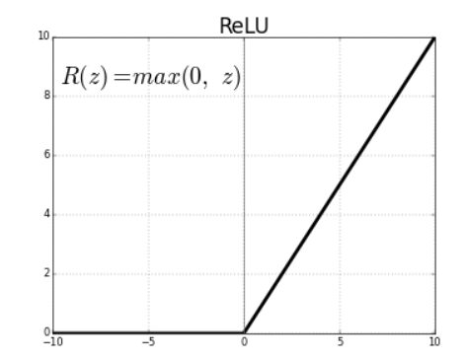
Method to overcome the problem
The vanishing gradient problem is caused by the derivative of the activation function used to create the neural network.
The simplest solution to the problem is to replace the activation function of the network.
Instead of sigmoid, use an activation function such as ReLU.
Rectified Linear Units (ReLU) are activation functions that generate a positive linear output when they are applied to positive input values.
If the input is negative, the function will return zero.

Slide 23
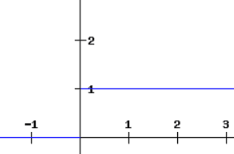
The derivative of a ReLU function is defined as 1 for inputs that are greater than zero and 0 for inputs that are negative. The graph shared below indicates the derivative of a ReLU function

Slide 24
Method to overcome the problem
If the ReLU function is used for activation in a neural network in place of a sigmoid function, the value of the partial derivative of the loss function will be having values of 0 or 1 which prevents the gradient from vanishing.
The use of ReLU function thus prevents the gradient from vanishing.
The problem with the use of ReLU is when the gradient has a value of 0. In such cases, the node is considered as a dead node since the old and new values of the weights remain the same.
This situation can be avoided by the use of a leaky ReLU function which prevents the gradient from falling to the zero value.

Slide 25
What is the dying ReLU problem?
A dying ReLU always outputs the same value, i.e., 0, on any input value. This condition is known as the dead state of ReLU neurons.
In this state, it is difficult to recover because the gradient of 0 is 0.
This becomes a problem when most of the input ranges are negative, or the derivative of the ReLU function is 0.
The gradient fails to flow during backpropagation because the outputs are 0, and hence the weights are not updated.
In the worst case, we get a constant function where the entire neural network dies. A network is born dead if it is dead before training.
As long as all the inputs push ReLU to non-negative segments, the dying ReLU problem doesn't occur.

Slide 26
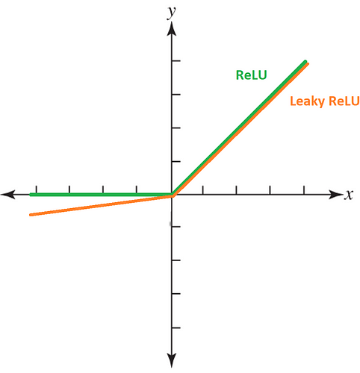
Recovering from dying ReLU
Different techniques are used to solve the dying ReLU problem.
i)Lowering the learning rates and negative bias
Lowering the learning rates and using a positive bias can mitigate the chance of dying ReLU.
This pushes the ReLU activation inputs to the non-negative side(+ve). This technique helps activate the neurons with the flow of gradient.
ii) Using Leaky ReLU
solves a dying ReLU problem by adding a slight slope in the negative range. This modifies the function to generate small negative outputs when input is less than 0.

Slide 27
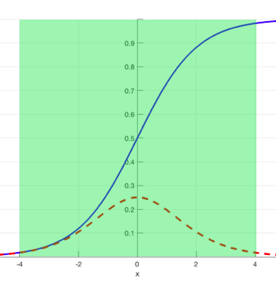
Mitigation of Vanishing Gradient problem
B) Batch normalization
The Vanishing Gradient problem arises when a large input space is mapped to a small one, causing the derivatives to disappear.
Batch normalization reduces this problem by simply normalizing the input so |x| doesn’t reach the outer edges of the sigmoid function.
As seen in fig, it normalizes the input so that most of it falls in the green region, where the derivative isn’t too small.

Slide 28
Mitigation of Vanishing Gradient problem
C) Weight Initialization
This is the process of assigning initial values to the weights in the neural network so that during back propagation, the weights never vanish.
D)Gradient clipping: Limiting the magnitude of the gradients can prevent them from becoming too small.
Eg: # inside the optimizer we are doing clipping optimizer=tf.keras.optimizers.SGD(clipvalue=0.5)
E)Residual connections: Residual connections allow the gradients to flow directly through the network, which can help to prevent them from becoming too small.
F)Architecture modifications: Changing the architecture of the network, such as using skip connections or recurrent connections, can help to prevent the gradients from vanishing.
By using these techniques, the vanishing gradient problem can be mitigated, allowing for more effective training of deep neural networks.

Slide 29
ReLU Heuristics for Avoiding Bad Local Minima
ReLU (Rectified Linear Unit) is a popular activation function used in deep learning neural networks.
It is a simple, non-linear function that is computationally efficient and has been shown to work well in a wide range of applications.
One potential issue with ReLU is that it can result in bad local minima during training.
This occurs when the gradient of the loss function becomes zero or close to zero, and the network is unable to improve its performance.

Slide 30
ReLU Heuristics for Avoiding Bad Local Minima
A local minimum problem in neural networks refers to the phenomenon of a neural network getting stuck in a suboptimal solution while training when the error function has multiple local minima g, due to the shape of the error function.
This can occur (i.e., points of low error) in addition to a global minimum (i.e., the point of lowest error).
If the neural network gets stuck in one of the local minima, it may not be able to find the global minimum and may achieve suboptimal performance.

Slide 31
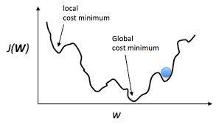
ReLU Heuristics for Avoiding Bad Local Minima

Slide 32
ReLU Heuristics for Avoiding Bad Local Minima
To avoid this problem, there are some heuristics that can be applied when using ReLU:
Initialization: Proper initialization of the weights can help to avoid bad local minima. A common technique is to initialize the weights with small random values.
Learning rate scheduling: Adjusting the learning rate during training can help to avoid bad local minima. Gradually decreasing the learning rate can allow the network to explore the parameter space more effectively.
Adding noise: Adding noise to the input data or the weights can help to avoid bad local minima. This can help the network to escape from the local minima and find better solutions.

Slide 33
ReLU Heuristics for Avoiding Bad Local Minima
Regularization: Regularization techniques, such as L1 or L2 regularization, can help to avoid overfitting and improve the generalization of the network. This can help to prevent the network from getting stuck in bad local minima.
Ensemble learning: Training multiple networks with different initializations and combining their outputs can help to avoid bad local minima. This can improve the performance and generalization of the network.
By applying these heuristics, it is possible to train deep neural networks using ReLU activation functions and avoid bad local minima. It is worth noting that while ReLU is a popular activation function, it is not always the best choice for every application, and other activation functions such as Leaky ReLU or ELU may be more appropriate in some cases.

Slide 34
Heuristics for Faster Training
There are several heuristics that can be applied to speed up the training process of deep learning models:
Mini-batch training: Instead of updating the weights after each individual training example, mini-batch training updates the weights after processing a small batch of examples. This can lead to faster convergence of the loss function and can make more efficient use of computational resources.
Early stopping: Training a deep learning model for too many epochs can lead to overfitting and slow down the training process. Early stopping is a technique that stops training the model when the performance on a validation set stops improving.
Learning rate scheduling: Adjusting the learning rate during training can help to speed up the training process. Initially, a high learning rate can be used to quickly converge to a reasonable solution, and then the learning rate can be gradually decreased to fine-tune the model.
Batch normalization: Batch normalization is a technique that can speed up training by reducing internal covariate shift. It normalizes the input to each layer of the network, which can help to reduce the number of epochs needed to train the model.

Slide 35
5. Transfer learning: Transfer learning is a technique that can speed up the training process by reusing pre-trained models. The pre-trained model can be used as a starting point for a new model, which can help to reduce the number of epochs needed to train the model.
6. Parallelization: Parallelization is a technique that can speed up the training process by distributing the computation across multiple devices or nodes. This can help to reduce the time needed to train the model, especially for very large datasets or models.
By applying these heuristics, it is possible to speed up the training process of deep learning models and reduce the time and resources needed to train high-quality models. However, it is worth noting that not all heuristics may be suitable for every application, and it is important to carefully consider the trade-offs between speed and performance when choosing which heuristics to use.

Slide 36
Batch normalization :
It is a process to make neural networks faster and more stable through adding extra layers in a deep neural network.
The new layer performs the standardizing and normalizing operations on the input of a layer coming from a previous layer.
A typical neural network is trained using a collected set of input data called batch. Similarly, the normalizing process in batch normalization takes place in batches, not as a single input.

Slide 37
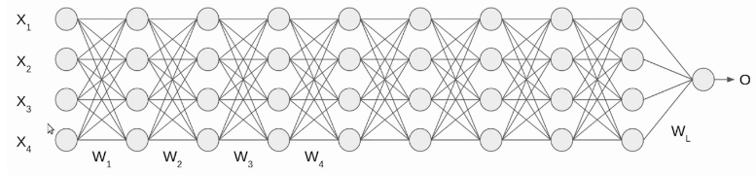
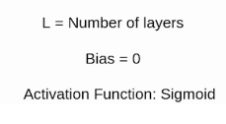
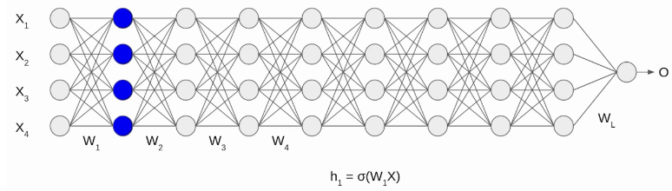
Batch normalization - Example
We have a deep neural network as shown in the following image.

Slide 38
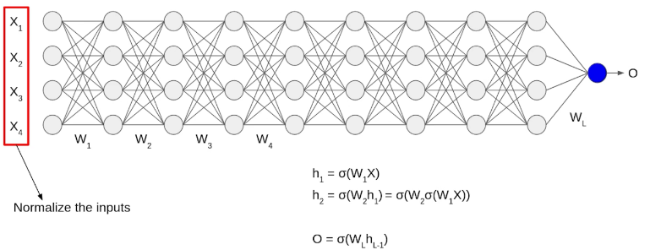
Initially, our inputs X1, X2, X3, X4 are in normalized form as they are coming from the pre-processing stage.
When the input passes through the first layer, it transforms, as a sigmoid function applied over the dot product of input X and the weight matrix W.
Similarly, this transformation will take place for the second layer and go till the last layer L as shown in the following image.

Slide 39
Batch normalization
Although, our input X was normalized with time the output will no longer be on the same scale.
As the data go through multiple layers of the neural network and L activation functions are applied, it leads to an internal co-variate shift in the data.

Slide 40

Batch Normalization working
It is a two-step process. First, the input is normalized, and later rescaling and offsetting is performed.
Normalization of the Input
Normalization is the process of transforming the data to have a mean zero and standard deviation one. In this step we have our batch input from layer h, first, we need to calculate the mean of this hidden activation.
Here, m is the number of neurons at layer h.

Slide 41


Once we have meant at our end, the next step is to calculate the standard deviation of the hidden activations.
We will normalize the hidden activations using these values. For this, we will subtract the mean from each input and divide the whole value with the sum of standard deviation and the smoothing term (ε).
The smoothing term(ε) assures numerical stability within the operation by stopping a division by a zero value.

Slide 42

Rescaling and Offsetting
In the final operation, the re-scaling and offsetting of the input take place. Here two components of the BN algorithm come into the picture, γ(gamma) and β (beta). These parameters are used for re-scaling (γ) and shifting(β) of the vector containing values from the previous operations.
These two are learnable parameters, during the training neural network ensures the optimal values of γ and β are used. That will enable the accurate normalization of each batch.

Slide 43
Drawbacks of gradient descent
The main drawback of gradient descent is that it depends on the learning rate and the gradient of that particular step only.
The gradient at the plateau, also known as saddle points of our function, will be close to zero. The gradient descent algorithm will get stuck.(no learning)
The step size becomes very small or even zero(Gradient Descent). Thus, the update of our parameters is very slow at a gentle slope.
Let us look at an example. The starting point of our model is ‘A’. The loss function will decrease rapidly on the path AB because of the higher gradient.
But as the gradient decreases from B to C, the learning is negligible.
The gradient at point ‘C’ is zero, and it is the saddle point of our function. Even after many iterations, we will be stuck at ‘C’ and will not reach the desired minimum ‘D’.

Slide 44
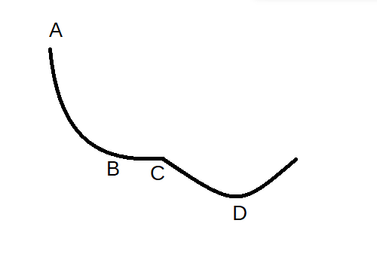
Drawbacks of gradient descent
This problem is solved by using momentum in our gradient descent.

Slide 45
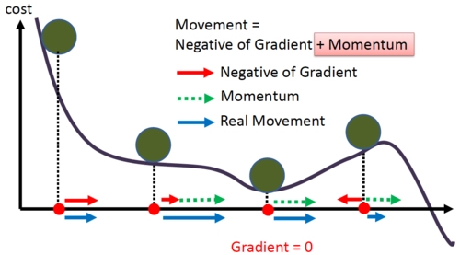
Gradient descent with momentum
The issue discussed above can be solved by including the previous gradients in our calculation.
The intuition behind this is if we are repeatedly asked to go in a particular direction, we can take bigger steps towards that direction.
If I am repeatedly being asked to move in the same direction then I should probably gain some confidence and start taking bigger steps in that direction. Just as a ball gains momentum while rolling down a slope.
The weighted average of all the previous gradients is added to our equation, and it acts as momentum to our step.

Slide 46
Gradient descent with momentum
As we start to descend, the momentum increases, and even at gentle slopes where the gradient is minimal, the actual movement is large due to the added momentum.
But this added momentum causes a different type of problem.
We actually cross the minimum point and have to take a U-turn to get to the minimum point. Momentum-based gradient descent oscillates around the minimum point, and we have to take a lot of U-turns to reach the desired point.
Despite these oscillations, momentum-based gradient descent is faster than conventional gradient descent.
To reduce these oscillations, we can use Nesterov Accelerated Gradient.

Slide 47
Update Rule for momentum-based gradient descent
Update Rule for momentum based gradient descent
Update rule for gradient descent: w_{t+1} = w_{t} − η∇wt In this equation, the weight (W) is updated in each iteration. η is the learning rate, and ∇wt is the gradient.
Update rule for momentum-based gradient descent: In this, momentum is added to the conventional gradient descent equation. The update equation is w_{t+1} = w_{t} − update_{t}
update_{t} is calculated by: update_{t} = γ · update_{t−1} + η∇w_{t}

Slide 48
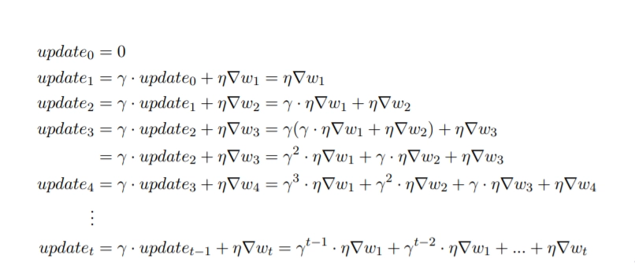

Slide 49
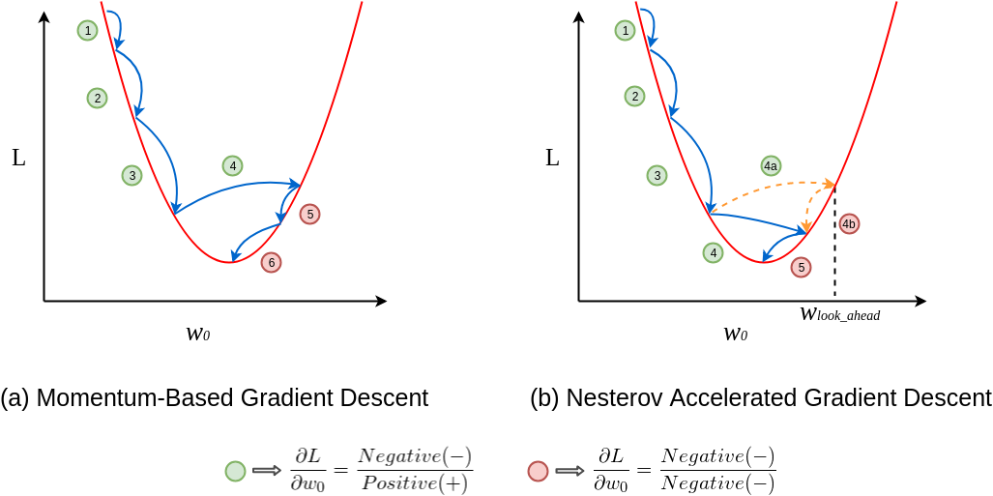
Nesterov Accelerated Gradient (NAG)
NAG resolves problem of momentum based by adding a look ahead term in our equation.
The intuition behind NAG can be summarized as ‘look before you leap’.
Let us try to understand this through an example.

Slide 50
In figure (a), update 1 is positive i.e., the gradient is negative because as w_0 increases L decreases.
Even update 2 is positive as well and you can see that the update is slightly larger than update 1, thanks to momentum.
By now, you should be convinced that update 3 will be bigger than both update 1 and 2 simply because of momentum and the positive update history.
Update 4 is where things get interesting.
In momentum case, due to the positive history, the update overshoots and the descent recovers by doing negative updates.

Slide 51
But in NAG’s case, every update happens in two steps — first, a partial update, where we get to the look_ahead point and then the final update :see figure (b).
First 3 updates of NAG are pretty similar to the momentum-based method as both the updates (partial and final) are positive in those cases.
But the real difference becomes apparent during update 4. As usual, each update happens in two stages, the partial update (4a) is positive, but the final update (4b) would be negative as the calculated gradient at w_lookahead would be negative.
This negative final update slightly reduces the overall magnitude of the update, still resulting in an overshoot but a smaller one when compared to the vanilla momentum-based gradient descent.
This is how NAG helps us in reducing the overshoots, i.e. making us take shorter U-turns.

Slide 52
As can see, in the momentum-based gradient, the steps become larger and larger due to the accumulated momentum, and then overshoot at the 4th step.
We then have to take steps in the opposite direction to reach the minimum point.
However, the update in NAG happens in two steps.
First, a partial step to reach the look-ahead point, and then the final update. We calculate the gradient at the look-ahead point and then use it to calculate the final update.
If the gradient at the look-ahead point is negative, our final update will be smaller than that of a regular momentum-based gradient.
Like in the above example, the updates of NAG are similar to that of the momentum-based gradient for the first three steps because the gradient at that point and the look-ahead point are positive. But at step 4, the gradient of the look-ahead point is negative.

Slide 53
We can see in the above example that the momentum-based gradient descent takes six steps to reach the minimum point, while NAG takes only five steps.
This looking ahead helps NAG to converge to the minimum points in fewer steps and reduce the chances of overshooting.

Slide 54
How NAG actually works?
We saw how NAG solves the problem of overshooting by ‘looking ahead’. Let us see how this is calculated and the actual math behind it.
Update rule for gradient descent: w_{t+1} = w_{t} − η∇wt In this equation, the weight (W) is updated in each iteration. η is the learning rate, and ∇wt is the gradient.
Update rule for momentum-based gradient descent: In this, momentum is added to the conventional gradient descent equation. The update equation is w_{t+1} = w_{t} − update_{t}
update_{t} is calculated by: update_{t} = γ · update_{t−1} + η∇w_{t}

Slide 55
This is how the gradient of all the previous updates is added to the current update.

Slide 56
NAG
Update rule for NAG: w_{t+1} = w_{t} − update_{t} While calculating the update_{t}, We will include the look ahead gradient (∇w_{look_ahead}). update_{t} = γ · update_{t−1} + η∇w_{look_ahead}
∇w_{look_ahead} is calculated by: w_{look_ahead} = w_{t} − γ · update_{t−1}
This look-ahead gradient will be used in our update and will prevent overshooting

Slide 57
In the case of the Nesterov gradient optimization technique, the weight update will occur in two steps, in the first step the weight update will occur due to the history of momentum and in the second step, the weight update will occur due to the look-ahead term.
So here the minima point will not be crossed and there will be a need for less number of epochs, which will make training fast.

Slide 58
Regularization
Regularization is a technique used in deep learning to prevent overfitting and improve the generalization performance of a neural network.
Overfitting occurs when a model learns to fit the training data too closely, resulting in poor performance on new, unseen data.

Slide 59
Regularization Techniques
There are several types of regularization techniques that can be used in deep learning:
L1 and L2 regularization: L1 and L2 regularization are techniques that add a penalty term to the loss function of the network. The penalty term is proportional to the L1 or L2 norm of the weights, respectively, and helps to prevent overfitting by encouraging the network to learn simpler, more generalizable models.
Dropout: Dropout is a technique that randomly drops out (sets to zero) a fraction of the neurons in a layer during training. This can help to prevent overfitting by forcing the network to learn more robust features that are not dependent on the presence of specific neurons.
Early stopping: Early stopping is a technique that stops training the model when the performance on a validation set stops improving. This can help to prevent overfitting by preventing the model from continuing to learn the training data too closely.

Slide 60
Regularization Techniques
Data augmentation: Data augmentation is a technique that artificially increases the size of the training dataset by applying random transformations to the data, such as rotation, translation, and scaling. This can help to prevent overfitting by providing the network with more diverse examples to learn from.
Batch normalization: Batch normalization is a technique that can help to prevent overfitting by reducing internal covariate shift. It normalizes the input to each layer of the network, which can help to stabilize the training process and reduce the risk of overfitting.
By applying these regularization techniques, it is possible to improve the generalization performance of deep learning models and prevent overfitting. However, it is important to carefully choose which regularization techniques to use and tune the hyperparameters appropriately, as different techniques may be more effective for different models and datasets.

Slide 61
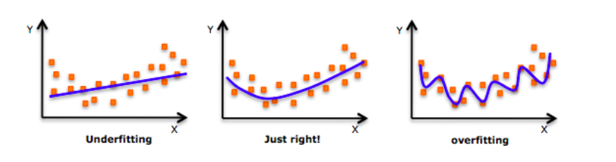
What is Regularization?
As we move towards the right in this image, our model tries to learn too well the details and the noise from the training data, which ultimately results in poor performance on the unseen data.

Slide 62
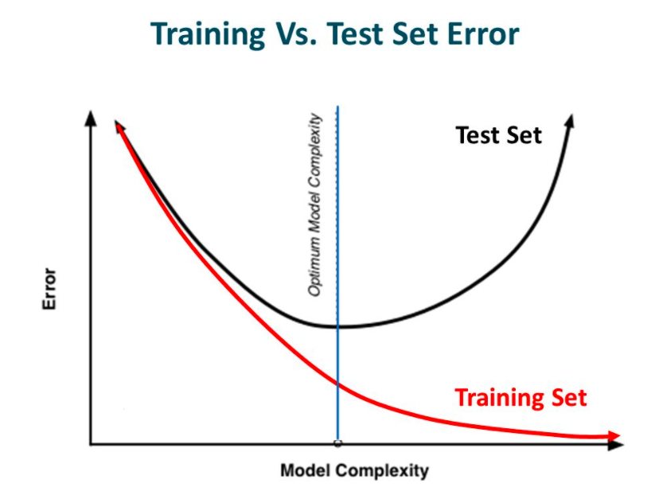
In other words, while going towards the right, the complexity of the model increases such that the training error reduces but the testing error doesn’t.

Slide 63
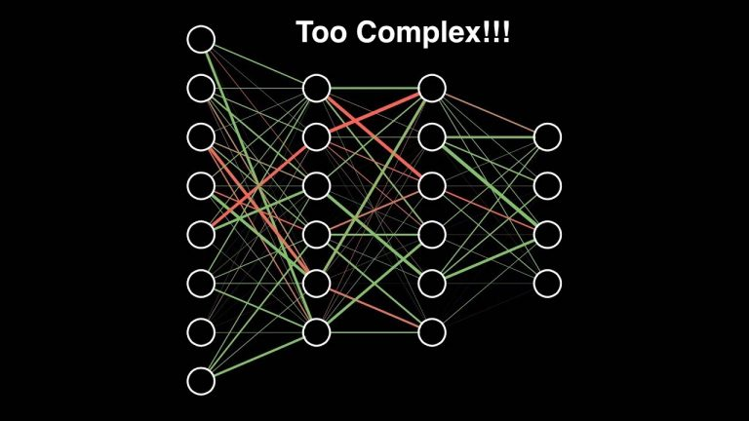
NN with multiple layers are complex . This makes them more prone to overfitting.

Slide 64
Regularization is a technique which makes slight modifications to the learning algorithm such that the model generalizes better.
This in turn improves the model’s performance on the unseen data as well.

Slide 65
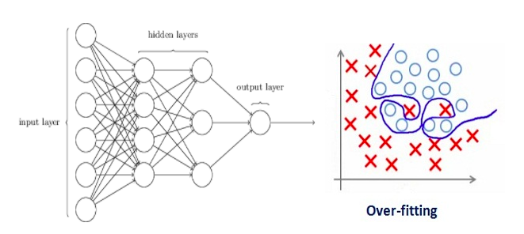
Regularization technique to reduce Overfitting:
Let’s consider a neural network which is overfitting on the training data as shown in the image below.

Slide 66
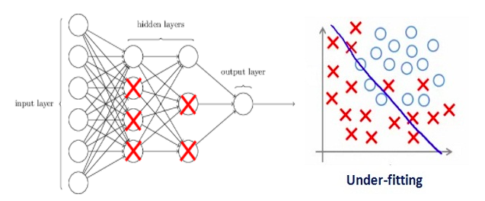
regularization penalizes the coefficients in machine learning. In deep learning, it actually penalizes the weight matrices of the nodes.
Assume that our regularization coefficient is so high that some of the weight matrices are nearly equal to zero.
This will result in a much simpler linear network and slight underfitting of the training data.

Slide 67
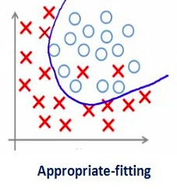
We need to optimize the value of regularization coefficient in order to obtain a well-fitted model as shown in the image below.

Slide 68
Different Regularization Techniques in Deep Learning
L2 & L1 regularization
L1 and L2 are the most common types of regularization. These update the general cost function by adding another term known as the regularization term.
Cost function = Loss+ Regularization term
Due to the addition of this regularization term, the values of weight matrices decrease because it assumes that a neural network with smaller weight matrices leads to simpler models.
Therefore, it will also reduce overfitting to quite an extent.

Slide 69
L2 regularization
According to regression analysis, L2 regularization is also called ridge regression.
In this type of regularization, the squared magnitude of the coefficients or weights multiplied with a regularizer term is added to the loss or cost function.
L2 regression can be represented with the following mathematical equation.

Slide 70
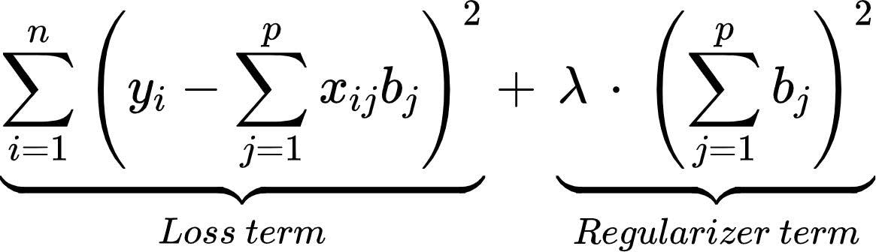
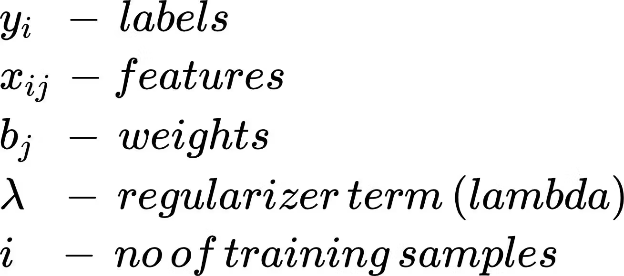

Slide 71
L2
You can see that a fraction of the sum of squared values of weights is added to the loss function. Thus, when gradient descent is applied on loss, the weight update seems to be consistent by giving almost equal emphasis on all features. You can observe the following:
Lambda is the hyperparameter that is tuned to prevent overfitting i.e. penalize the insignificant weights by forcing them to be small but not zero.
L2 regularization works best when all the weights are roughly of the same size, i.e., input features are of the same range.
This technique also helps the model to learn more complex patterns from data without overfitting easily.

Slide 72
L1 regularization
L1 regularization is also referred to as lasso regression.
In this type of regularization, the absolute value of the magnitude of coefficients or weights multiplied with a regularizer term is added to the loss or cost function. It can be represented with the following equation.

Slide 73
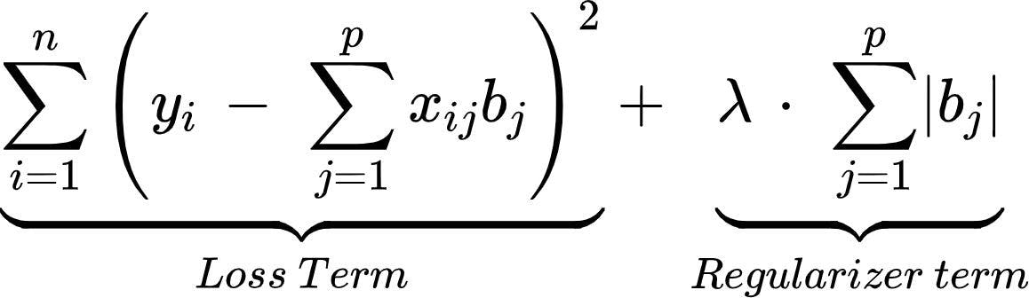


Slide 74
L1 Regularization
A fraction of the sum of absolute values of weights to the loss function is added in the L1 regularization. In this way, you will be able to eliminate some coefficients with lesser values by pushing those values towards 0. You can observe the following by using L1 regularization:
Since the L1 regularization adds an absolute value as a penalty to the cost function, the feature selection will be done by retaining only some important features and eliminating the lower or unimportant features.
This technique is also robust to outliers, i.e., the model will be able to easily learn about outliers in the dataset.
This technique will not be able to learn complex patterns from the input data.

Slide 75
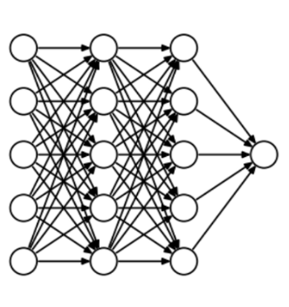
Dropout
This is the one of the most interesting types of regularization techniques. It also produces very good results and is consequently the most frequently used regularization technique in the field of deep learning.
To understand dropout, let’s say our neural network structure is akin to the one shown below:

Slide 76
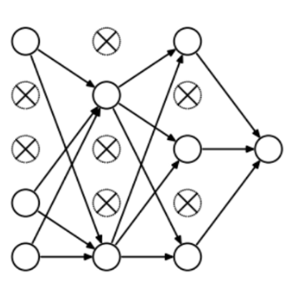
Dropout
At every iteration, it randomly selects some nodes and removes them along with all of their incoming and outgoing connections as shown below.

Slide 77
Dropout
So each iteration has a different set of nodes and this results in a different set of outputs. It can also be thought of as an ensemble technique in machine learning.
Ensemble models usually perform better than a single model as they capture more randomness. Similarly, dropout also performs better than a normal neural network model.
This probability of choosing how many nodes should be dropped is the hyperparameter of the dropout function.
dropout can be applied to both the hidden layers as well as the input layers.

